Slide 1

Reinforcement Learning Mastery of Snake Game using Deep Q-Networks
Team Members:
Spandana
Sunaina Makkena

Slide 2
Project Topic: Implementation of a Deep Reinforcement Learning agent for the classic Snake game using Deep Q-Networks (DQN)
Autonomous gameplay through neural network training
Real-time demonstration of learned behaviors
Performance analysis and visualization

Slide 3
Project Objectives
Design and implement a functional Snake game environment in Pygame
1
Develop a DQN model capable of learning optimal Snake gameplay strategies
2
Achieve consistently high scores (10+ food items consumed) in autonomous play
3
Visualize and analyze the learning process and agent decision-making
4
Compare performance across different hyperparameter configurations
5

Slide 4
Approach
Tools:
Python with PyTorch for neural network implementation
Pygame for game environment
NumPy for data manipulation
Matplotlib for visualization
Techniques:
Deep Q-Network (DQN) with experience replay
Epsilon-greedy exploration strategy

Slide 5
DELIVERABLES
Documentation Model: Detailed instructions (Documentation model) on how we trained our Snake game agent using Deep Q-Network (DQN) reinforcement learning, including state representation, network architecture, and hyperparameter tuning process.
Presentation: A video on YouTube showing how our DQN agent plays the Snake game at different training stages, along with a presentation slide detailing performance metrics.
GitHub: A link to our project's code and related files on GitHub, including the complete implementation, training scripts, and visualization tools.

Slide 6
Evaluation Methodology
Quantitative Metrics:
Average Score : Measure the average number of food items collected over 100 test games.
Success Rate : Compute the proportion of games where the agent scores 10 or more points, i.e Success Rate = (Number of games with score ≥ 10) / (Total games)
Training Convergence Time : Track how many episodes or training steps are required for the model to reach stable performance.
Average Survival Time : Measure how long the agent survives on average per episode (in terms of game steps or time).
Qualitative Assessment:
Visual Demonstration : Observe whether the agent exhibits intelligent gameplay behavior during test runs.
Complex Navigation : Check the agent’s ability to handle complex scenarios (e.g., tight corners or avoiding collisions).
Agent Comparison : Compare the trained DQN agent's performance against.
A random agent
A rule-based agent
Learning Curve Visualization : Plot metrics like reward, score, and loss across episodes to show learning progression and performance improvement.

Slide 7
Results
Learning Curve Visualization: Reward, score, and loss plotted across training episodes.
Quantitative Metrics:
Average Score: Improvement across episodes.
Success Rate: Percentage of games where the agent scores ≥ 10.
Training Convergence Time: Number of episodes needed for stabilization.
Average Survival Time: Game steps before failure.
Comparison Across Models:
DQN vs. Random Agent
DQN vs. Rule-Based Agent
Observations:
Improved gameplay strategy over time.
Effective collision avoidance and navigation in complex scenarios.
Adaptive learning from past experiences for better decisions.

Slide 8
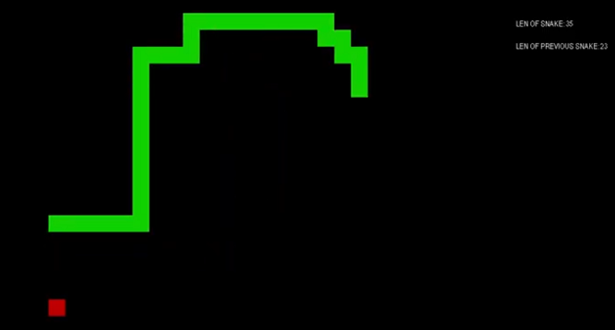
Rewards
The total reward is calculated for each episode, which is continued for 30 games. We collect average total reward for every 100 consecutive episodes. The threshold is unknown. The snake's length and reward increase by 1 each time an apple is eaten. The reward is reduced by 1 every time the snake collides with itself, bumps into the border of the board, or if it does not eat an apple for a long time.
Actions
0 - turn left, 1 - turn right, 2 - move up, 3 - move down

Slide 9
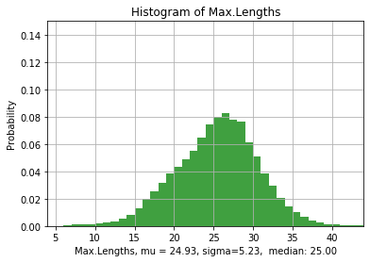
Snake’s Length
For any 100 consecutive episodes we get value 'Avg.LenOfSnake' adn 'Max.LenOfSnake'.
For Learning rate = 1e-4, number of episodes = 50000 Avg.LenOfSnake = 18, Max.LenOfSnake = 46

Slide 10
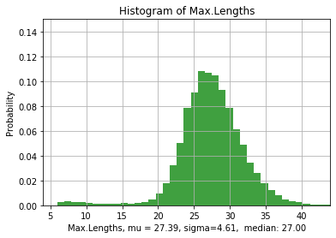
Snake’s Length
For Learning rate = 1e-5, number of episodes = 60000 Avg.LenOfSnake = 18, Max.LenOfSnake = 44

Slide 11
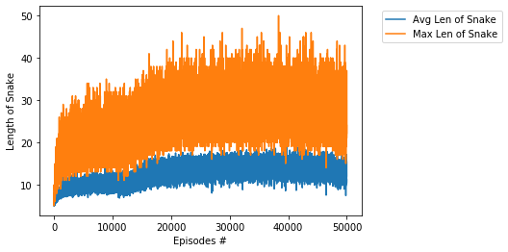
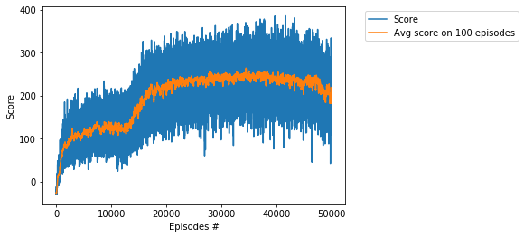
Train
For Learning rate = 1e-4, number of episodes = 50000

Slide 12
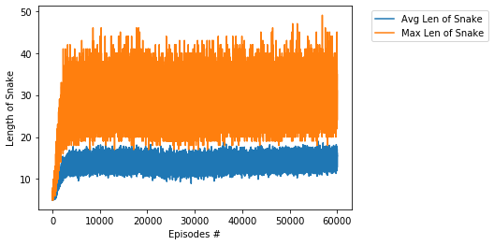
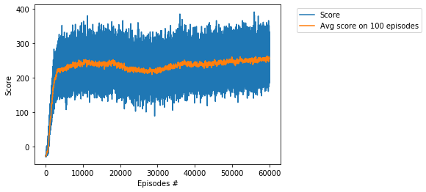
Train
For Learning rate = 1e-5, number of episodes = 60000

Slide 13
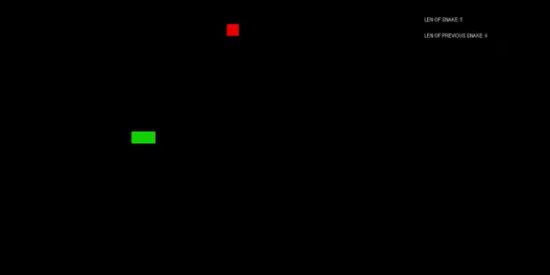
Demo Video

Slide 14
Final Thoughts and Next steps
Key Learnings:
DQN successfully enables autonomous gameplay.
Hyperparameter tuning significantly affects learning speed and efficiency.
Exploration-exploitation balance crucial for optimal strategy development.
Potential Improvements:
Experiment with advanced RL algorithms (PPO, A3C) for better performance.
Fine-tune network architecture and hyperparameters to maximize efficiency.
Implement adaptive learning strategies for more dynamic AI behavior.
Next Steps:
Optimize training cycles to reduce computation costs.
Explore multi-agent reinforcement learning for competitive Snake scenarios.
Community Collaboration: Share findings, receive feedback, and expand project scope.

